Slide 1
Template for Short Abstracts for the 2nd biennial international congress of new challenges of sports sciences and health on the Silk Road, 2023 Author name [Please list all authors here and do not include abbreviated qualifications]¹ , Author name² ¹Author affiliations [list all author affiliations in the form of department, institution, city, state, country], email@gmail/yahoo.com ²Author affiliations [list all author affiliations in the form of department, institution, city, state, country], email@gmail/yahoo.com

Slide 2
Introduction
This template can be used for submission to the 2nd biennial international congress of new challenges of sports sciences and health on the Silk Road. The abstract should not be exceed 300 words.

Slide 3
Method:
The research method is the …..

Slide 4
Results:
The result of the study showd that there is ……
Figure 1. Example graph for the extended abstract.

Slide 5
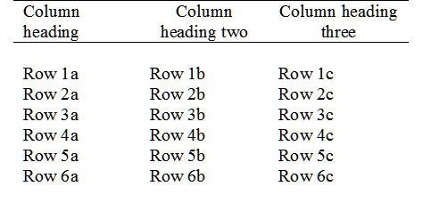
Results:
The result of the study showd that there is ……
Table 1. Example table for the extended abstract.

Slide 6
Conclusion:
In fact can said that use of authority and chose of type of authority in organization can be subjected to the philosophical mindset.
Logical and accurate thinking of director depends on his/her philosophical mindset.

Slide 7
References:
[1] Smith, T., Jones, M.: 'The title of the paper', Hum. Fact., 2017, 1, (8), pp. 1–7
[2] Smith, T., Jones, M.: 'The title of the paper', IET Syst. Biol., 2007, 1, (2), pp. 1–7
[3] Borwn, L., Thomas, H., James, C., et al.:'The title of the paper, IET Communications, 2012, 6, (5), pp 125-138
[4] Hodges, A., Smith, N.: 'The title of the book chapter', in Brown, S. (Ed.): 'Handbook of Systems Biology' (IEE Press, 2004, 1st edn.), pp. 1–7

